Slide 1
Development in Global Electrification
CISC7201 Course Project
Group U
M-B9-5517-1 Susan, Ho Mei San
M-B9-5520-1 Anne, U Wai Cheng
M-B9-5562-7 Hito, Chen Haitao

Slide 2
Terminology
Electrification rate
The percentage of people who have access to electricity in a given area
Access deficit
The number of people who do not have access to electricity in a given area

Slide 3









Python Libraries
The following libraries are used in this project:

Slide 4
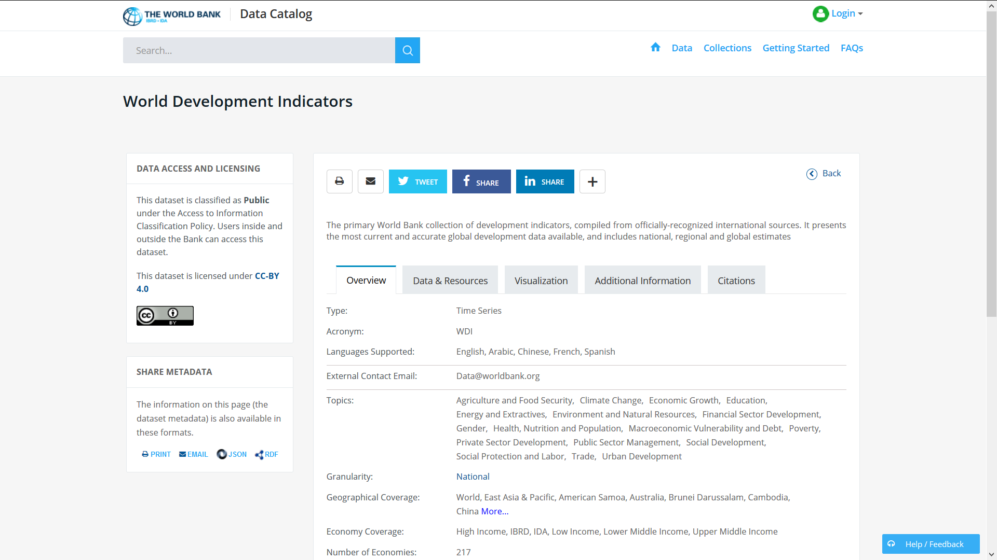
Data Source
Link: https://datacatalog.worldbank.org/dataset/world-development-indicators
“World Development Indicators” zip file
Total uncompressed Size: 245MB
6 csv files

Slide 5
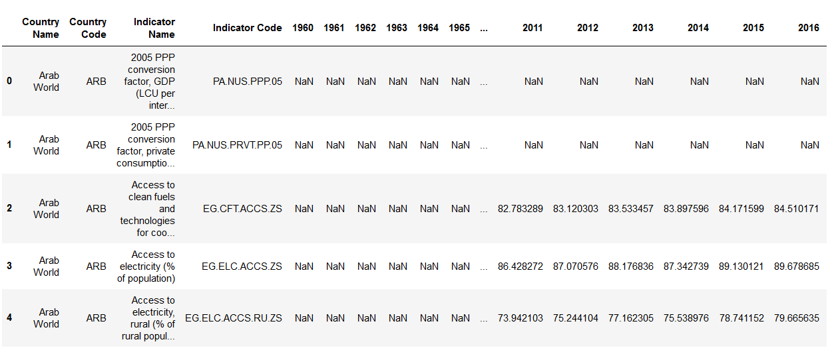
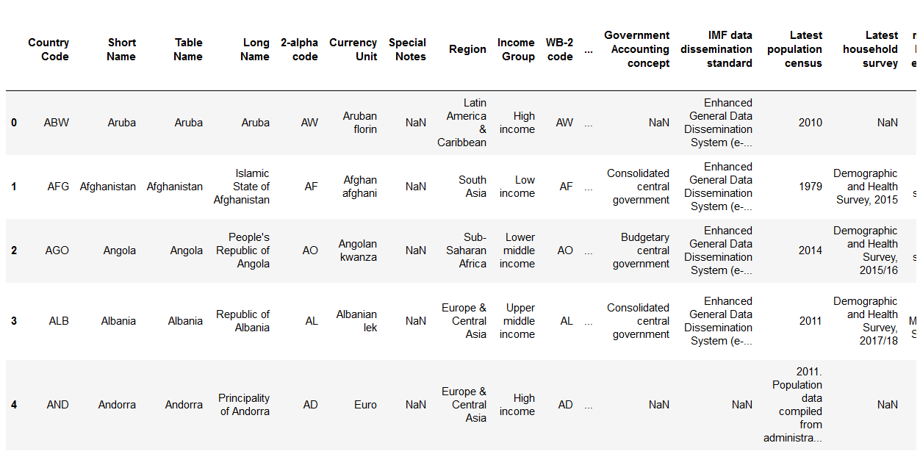
Data Preview
WDIData.csv: 377,784 rows × 65 columns (186MB)
WDICountry.csv: 263 rows × 31 columns (127kB)

Slide 6
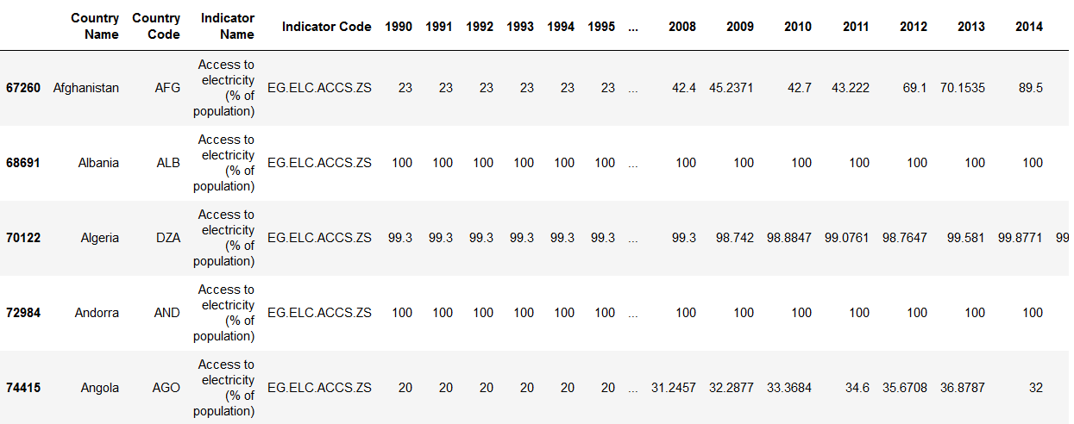
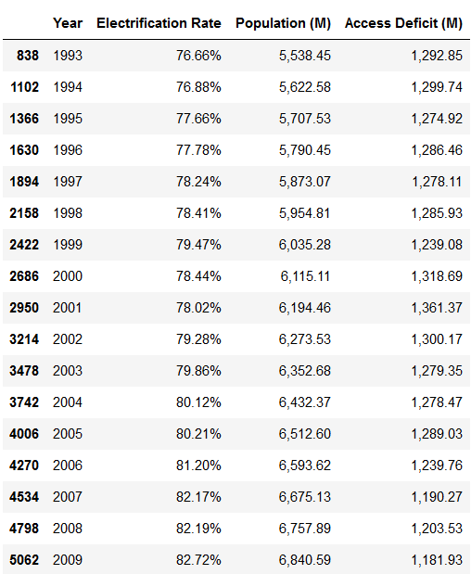
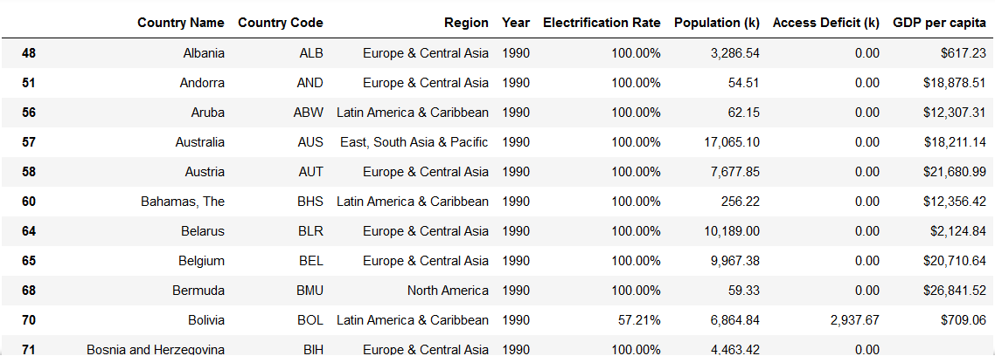
Data Cleansing and Processing
Results:

Slide 7
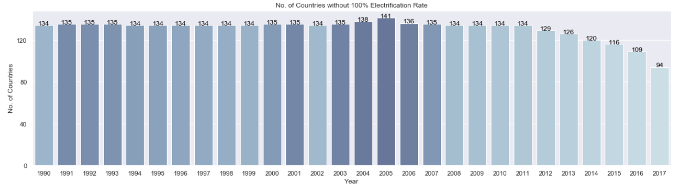
Data Visualization
Number of countries whose electrification rate <100%:

Slide 8
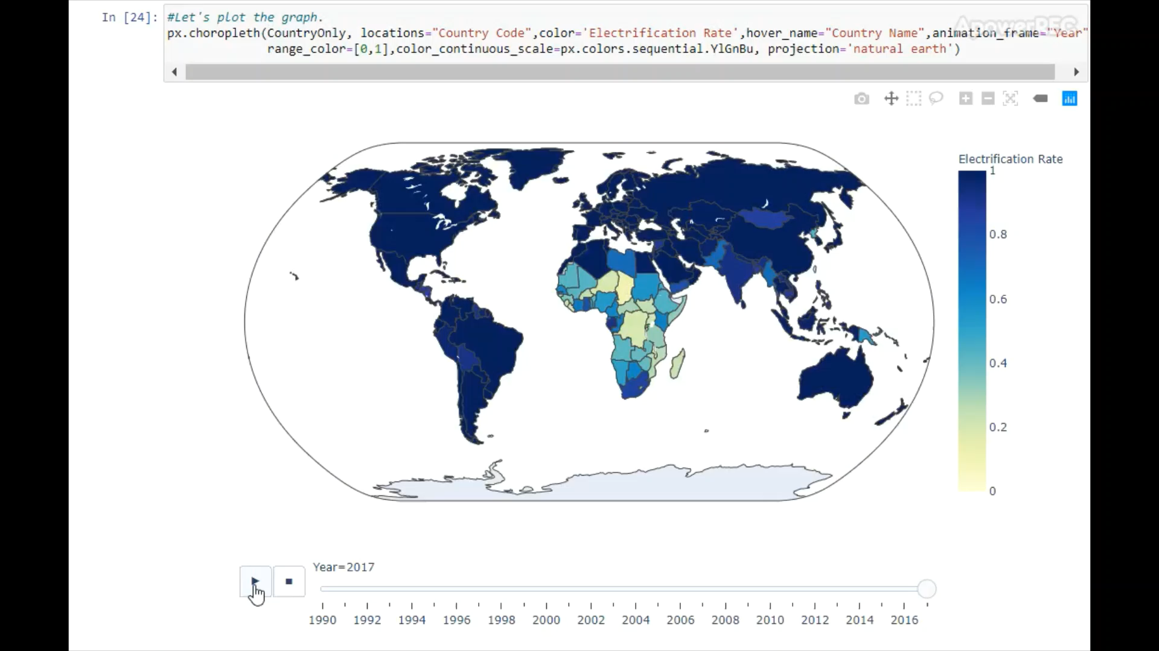
Data Visualization
Movement of Electrification Rate: 1990-2017

Slide 9
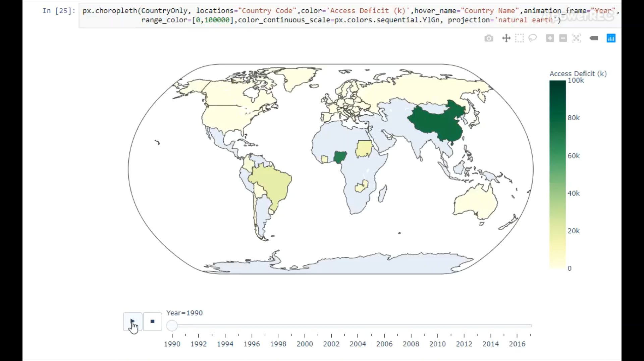
Data Visualization
Movement of Access Deficit: 1990-2017

Slide 10
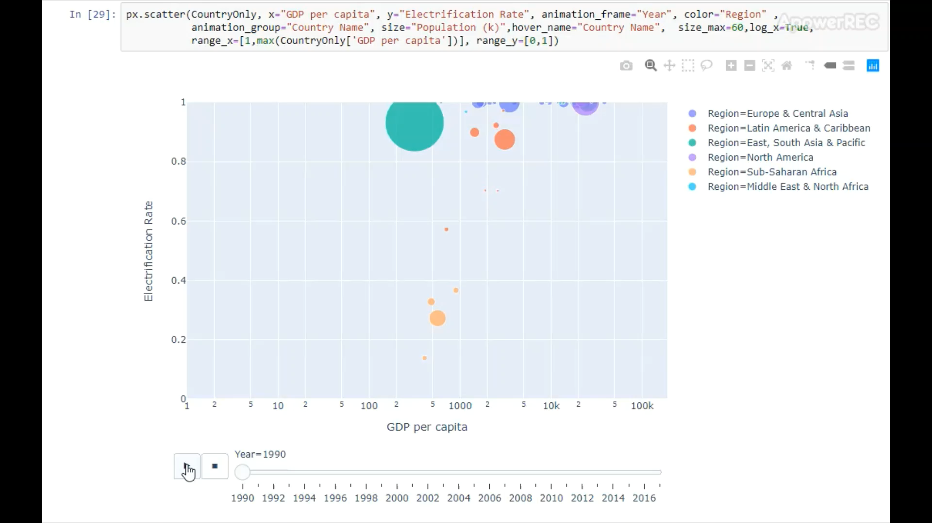
Data Visualization
Movement of GDP per capita vs Electrification Rate: 1990-2017

Slide 11
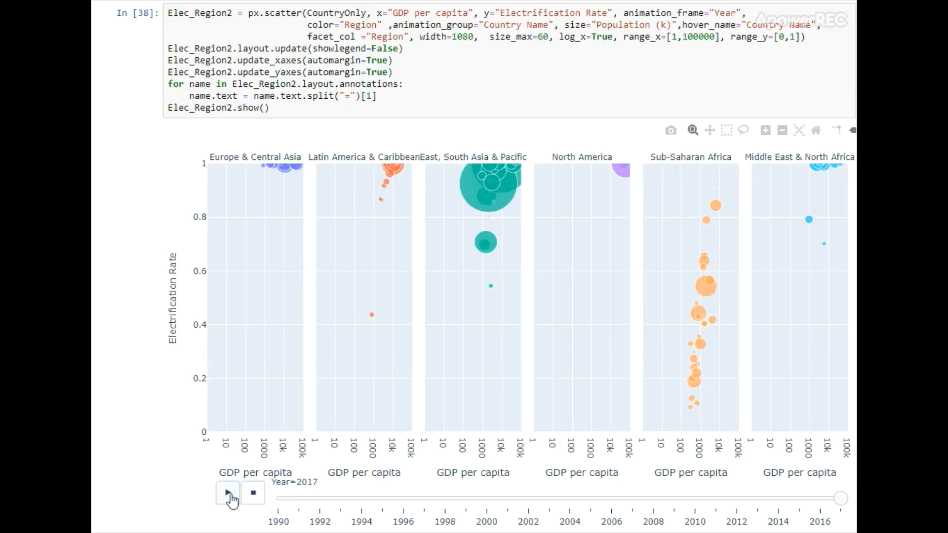
Data Visualization
Movement of GDP per capita vs Electrification Rate: 1990-2017

Slide 12
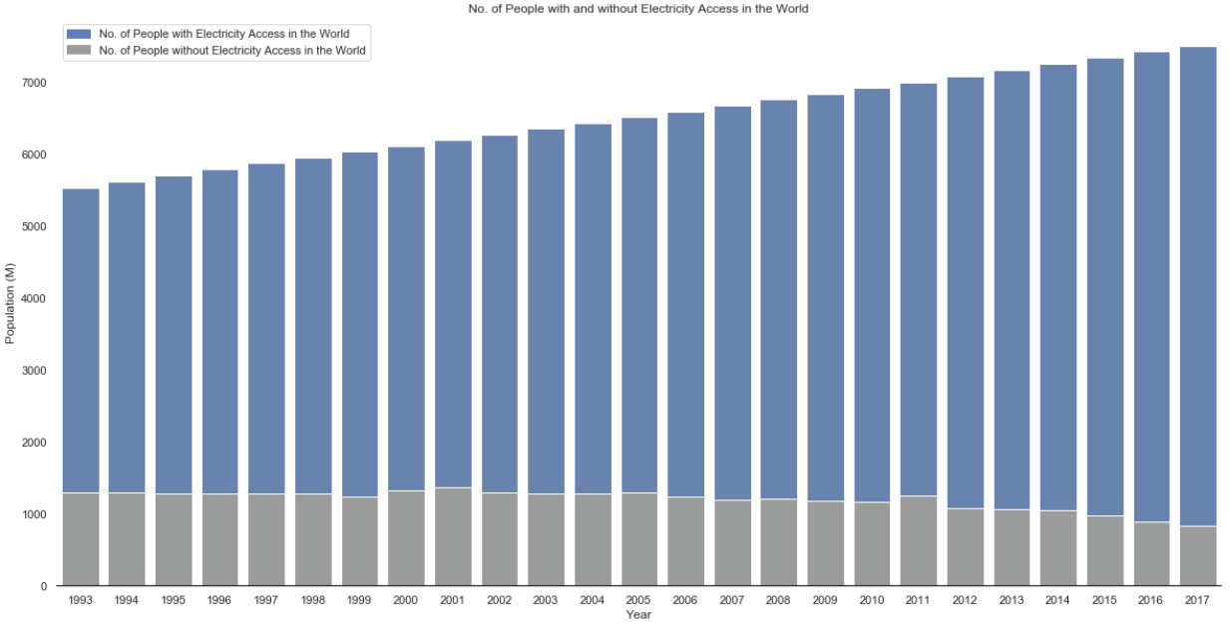
Data Visualization
Number of Population with & without Electricity Access in the World

Slide 13
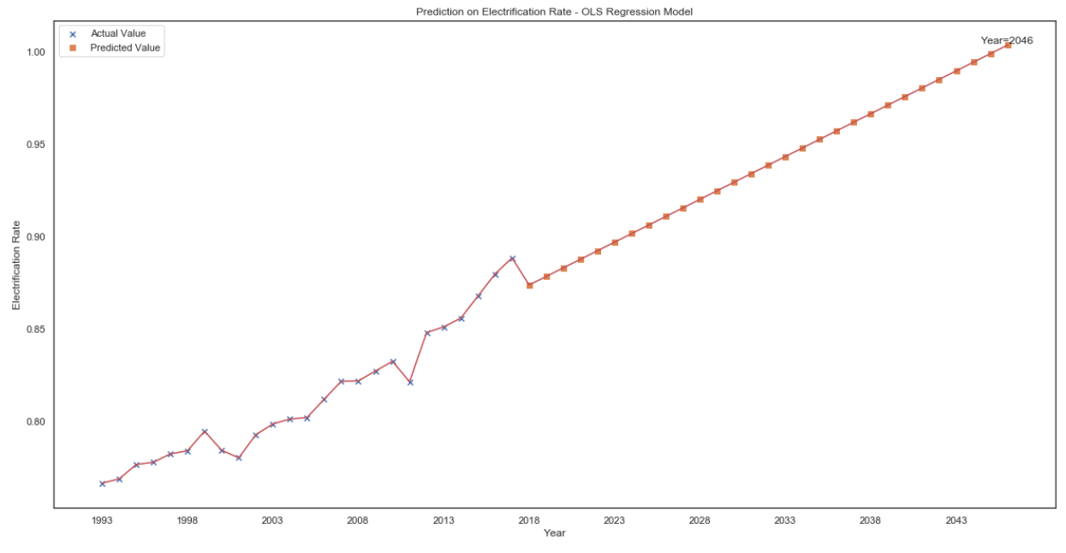
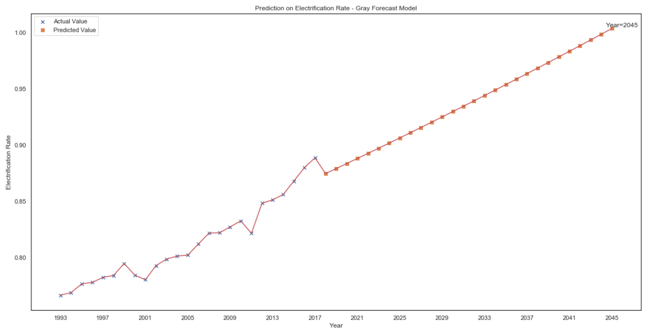
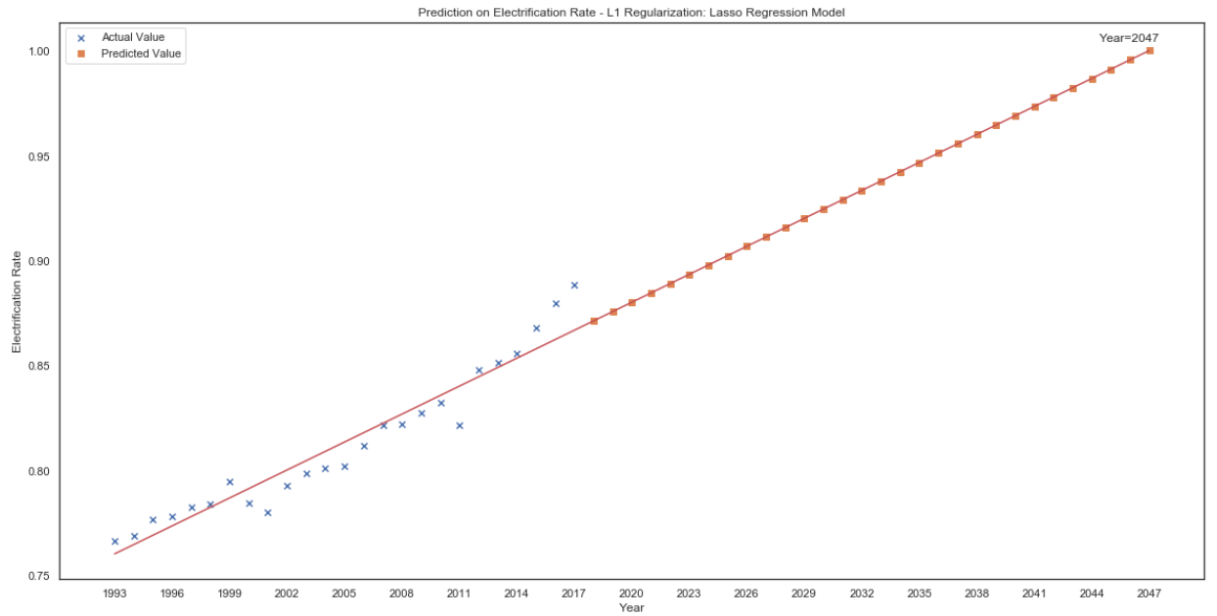
Data Forecast
When will global electrification rate = 100%?
OLS Regression Model: 2046
Gray Forecast Model: 2045
Lasso Regression Model (L1 Regularization): 2047

Slide 14
Thank You
Q&A

